Slide 1
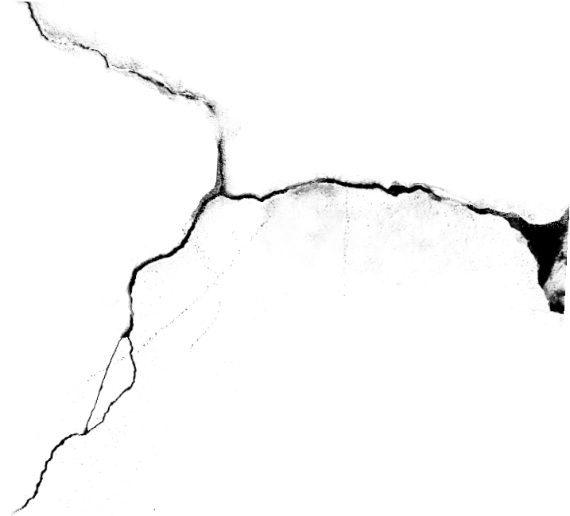
Gaming Beyond the Walls
How do Videogames Break the Fourth Wall?
BA Proposal
Teo Jia Xian (Jan)
98498582

Slide 2
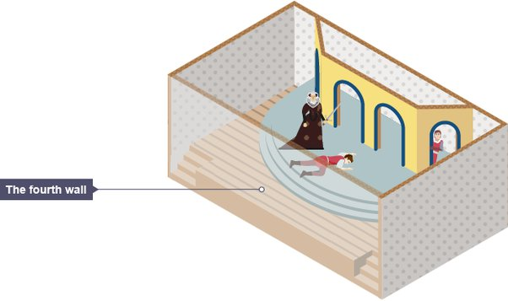
What is the Fourth Wall?
An imaginary wall that separates the actors from the audience.

Slide 3
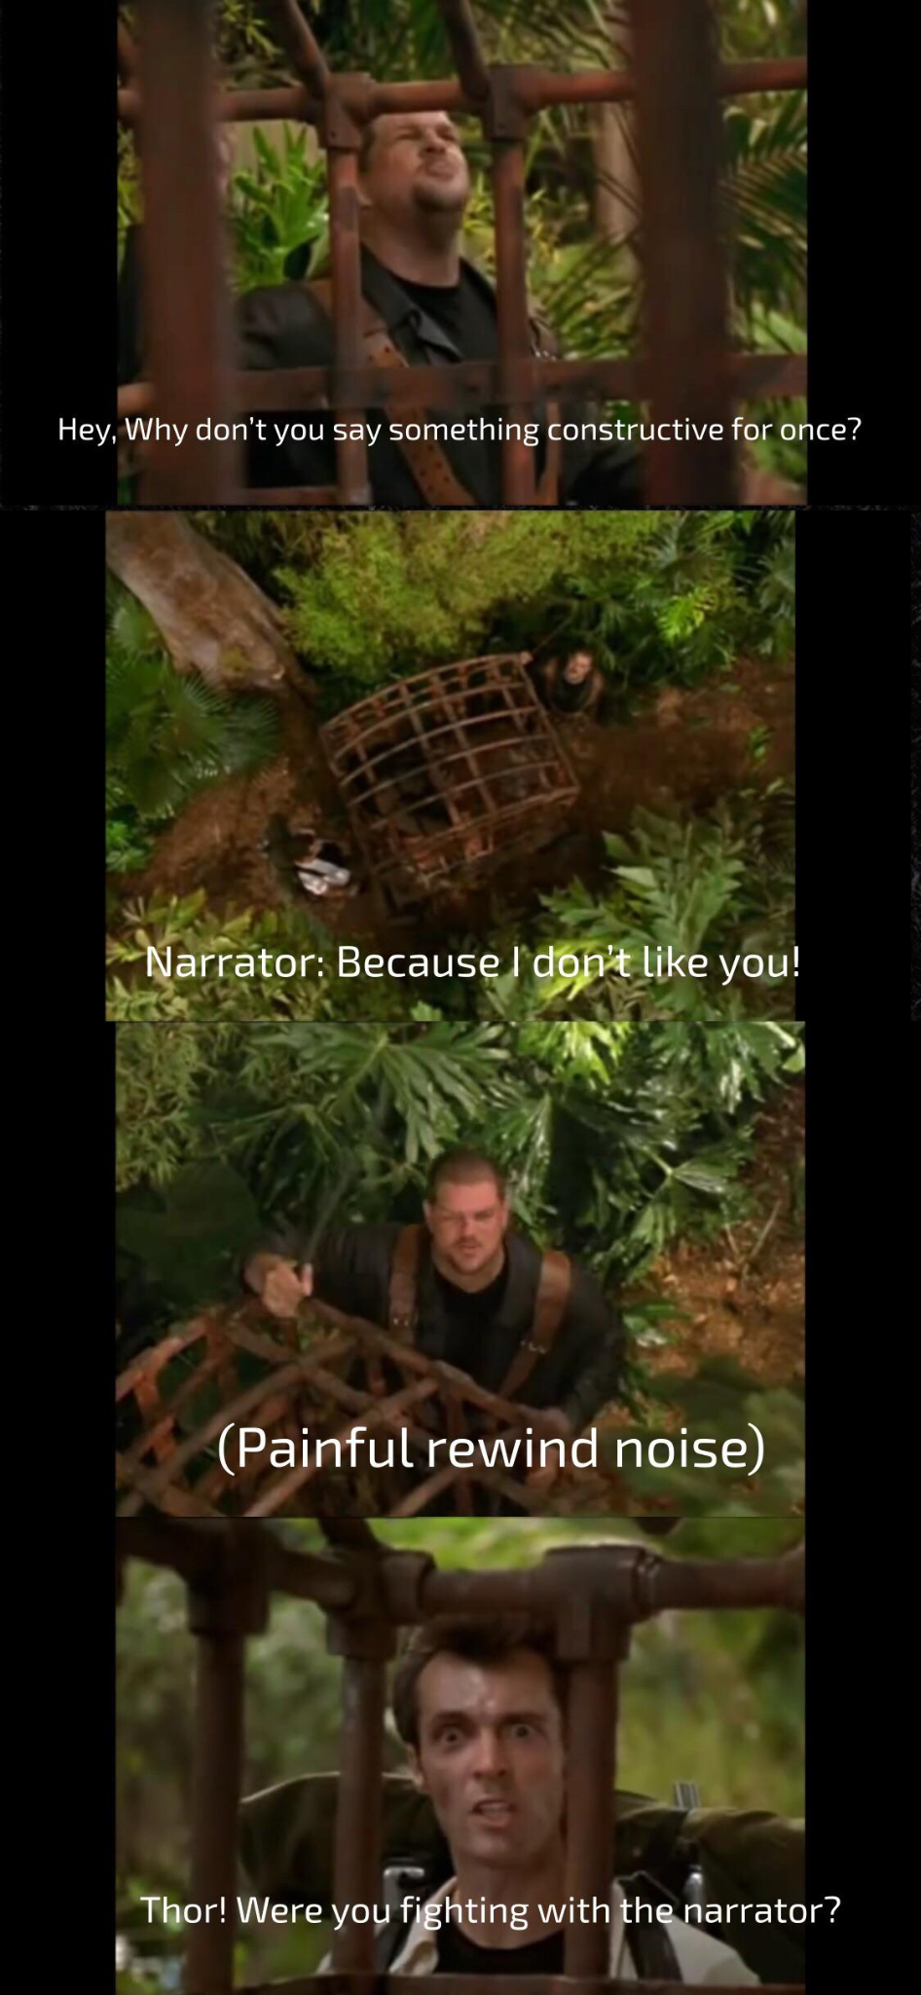




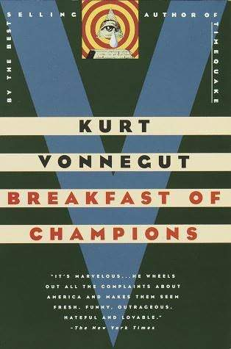

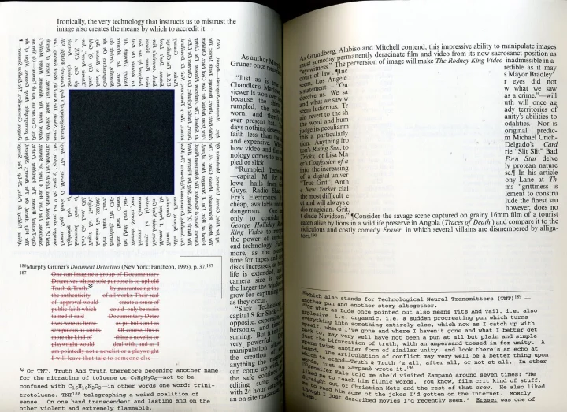





Slide 4
There’s a problem…
The interactive nature of games.
The player is both the actor and the audience in a game.
- Newman (2002)

Slide 5
Abstract
This paper would like to explore the meaning of the fourth wall within the space of video games and how it could possibly work.
Ultimately, it hopes to establish a basic guideline on possible narrative and mechanical designs game developers could reference to achieve the desired results.

Slide 6
The Fourth Wall in the Context of Videogames
Huizinga’s concept of The Magic Circle
Juul’s concept of the Puzzle Piece
Conway’s Expansion and Contractions of The Magic Circle
Liebe’s There is No Magic Circle in Computer Games
Galloway’s Radical Action in Countergaming
Fourth Wall == Magic Circle??

Slide 7
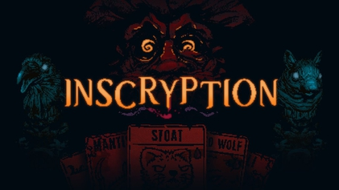





Fourth Wall Breaks in Videogames
Easter eggs / Intertextuality
Direct addressal
Lost of control
Multiple Narrative Layers

Slide 8
Possible Project Idea
A short game that attempts to incorporate as many fourth wall-breaking elements listed.
The game would have to consist of mechanics that requires the player to act beyond the confines of the video-game in an attempt to breach the fourth wall.

Slide 9
Why did I pick this topic?
Sounded fun.
Personally I’ve always liked fourth wall breaking elements in movies, shows and games, not just for their comedic aspects but their ability to add a certain depth to the narrative in their respective media when done tastefully.

Slide 10

Thank You

Slide 11
Bibliography
Conway, Steven. “A circular wall? Reformulating the fourth wall for videogames.” Journal of Gaming amp; Virtual Worlds 2, no. 2 (2010): 145–155.
Galloway, Alexander R. “Countergaming.” In Gaming: Essays on Algorithmic Culture, NED - New edition, 18:107–126. University of Minnesota Press, 2006
Huizinga, J. Homo ludens-a study of the play element in culture. Beacon press, 1950.
Juul, Jesper. “The magic circle and the puzzle piece.” 2008
Liebe, Michael. “There is no magic circle : on the difference between computer games and traditional games.” 2008
Newman, James. “The Myth of the Ergodic Videogame - Some thoughts on player-character relationships in videogames.” Game Studies 2 (July 2002)
Salen, Katie, and Eric Zimmerman. Rules of Play: Game Design Fundamentals, 672. MIT Press, 2004

